Slide 1


VLSI BASED RATION AUTHORIZATION SYSTEMS
DEPARTMENT OF ELECTRONICS AND COMMUNICATION ENGINEERING
Presented by Under the Supervision of
LOGESWARI B(811722106044) Mr.M .RAJA,M.E.,(Ph.D)
MAHALAKSHMI M(811722106048) ASSISTANT PROFESSOR
MAMATHIKA M(811722106049) DEPARTMENT OF ELECTRONICS AND COMMUNICATION ENGINEERING
20EC8501-PROJECT WORK

Slide 2


SUSTAINABLE DEVELOPMENT GOALS ADDRESSED
SDG 9 promotes innovation and the development of reliable infrastructure through advanced technology. The VLSI Based Ration Authorization System uses VLSI and embedded technology to improve the efficiency and security of the ration distribution system. It supports digital infrastructure, reduces manual errors, and ensures transparent and reliable public service delivery.
SDG 16 focuses on building transparent and accountable institutions. The VLSI Based Ration Authorization System prevents fraud, ensures secure beneficiary authentication, and improves transparency in the ration distribution process, thereby strengthening public welfare systems.
3/16/2026

Slide 3
PO/PSO MAPPING
Mapped PSO: PSO3 – Embedded Systems and VLSI
Reason:
The project involves embedded system implementation using VLSI design principles to develop a secure ration authorization mechanism for the Public Distribution System.
The system integrates hardware components such as authentication modules, microcontroller/processor units, sensors, and digital interfaces to verify and authorize beneficiaries before distributing ration materials.
It performs real-time data processing and authentication, ensuring that only eligible users can access ration supplies, thereby preventing unauthorized usage and duplication.
The project demonstrates hardware–software integration, digital system design, and secure data processing, which are fundamental concepts in Embedded Systems and VLSI engineering.
3/16/2026

Slide 4
OUTLINE
Abstract​
Objective of the Project​
Novelty of the Project​
Literature Survey​
Existing Method​
Analysis and Explanation of the Identified Problem​
Proposed Method​
Methodology
Flow Diagram
Block Diagram
Circuit Diagram
Hardware Implementation
Testing and Results
Conclusion
References
3/16/2026

Slide 5
ABSTRACT
The VLSI Based Ration Authorization System is designed to improve the efficiency and security of the Public Distribution System (PDS). It uses VLSI and embedded system technology to authenticate beneficiaries before distributing ration supplies. The system helps prevent fraud, duplicate ration cards, and unauthorized access. By automating the authorization process, it ensures transparent, accurate, and fair distribution of essential commodities.
The system reduces human intervention and minimizes errors in ration distribution. It also improves monitoring and control of ration delivery. The use of VLSI technology enables faster processing and reliable system performance. Overall, the system supports efficient food distribution and strengthens public welfare services.
3/16/2026

Slide 6
OBJECTIVE OF THE PROJECT
To develop a secure ration authorization system using VLSI technology.
To prevent unauthorized access and duplicate ration cards in the Public Distribution System.
To ensure fair and transparent distribution of food grains to eligible beneficiaries.
To reduce human errors and fraud in ration distribution. To design a smart ration stock monitoring system using FPGA technology.
To develop a MATLAB GUI for collecting ration requirements from consumers.
To implement UART communication between MATLAB and FPGA for reliable data transfer.
3/16/2026

Slide 7
NOVELTY OF THE PROJECT
The project introduces a VLSI-based hardware authorization system to improve the security and efficiency of the Public Distribution System.
It provides a secure electronic authentication mechanism to prevent duplicate ration cards and unauthorized access.
The system enables automated and real-time verification of beneficiaries, reducing manual errors and corruption.
It integrates embedded system technology with ration distribution, improving transparency and monitoring.
The proposed system ensures faster processing, reliability, and efficient food distribution through advanced hardware design.
3/16/2026

Slide 8
LITERATURE SURVEY
Year of publication | Title & Author | Technology Implemented | Gaps | Limitations
2025 | Smart Ration Distribution System Using Biometric Authentication — Sharma, P. et al. | Fingerprint Sensor + Embedded Controller | Limited hardware security | Sensor failure affects authentication
2025 | IoT Based Smart Public Distribution System — Kumar, R. et al. | IoT Module + Cloud Database | Security concerns in data transmission | Internet dependency
2024 | RFID Based Ration Distribution System — Patel, M. et al. | RFID Card + Microcontroller | No strong user authentication | Card duplication possible
2024 | Biometric Enabled Smart Ration System — Singh, A. et al. | Fingerprint Module + Database | Limited scalability | Slow authentication during high usage
2024 | Digital Ration Distribution Using Embedded System — Gupta, S. et al. | Embedded Controller + Sensors | Lack of automation | Manual monitoring required
3/16/2026

Slide 9
LITERATURE SURVEY
Year of publication | Title & Author | Technique Used | Gaps | Limitations
2023 | Smart Ration Shop Using IoT Technology — Reddy, V. et al. | IoT Sensors + Wireless Communication | Limited data privacy protection | Network reliability issues
2023 | Automated Ration Distribution System Using RFID — Das, K. et al. | RFID Reader + Motor Control | Weak security mechanism | Unauthorized card usage possible
2023 | Online Ration Monitoring System — Verma, D. et al. | Web Server + Database | No real-time hardware integration | Server downtime affects service
2022 | Biometric Smart Card Based Ration Distribution — Joseph, T. et al. | Smart Card + Biometric Verification | Limited system flexibility | High implementation cost
2022 | Embedded Based Smart Ration Authorization System — Rahman, M. et al. | Embedded Processor + Authentication Module | No VLSI optimization | Higher power consumption
3/16/2026

Slide 10
EXISTING METHOD
In the existing ration distribution system, stock management and consumer record maintenance are largely performed manually or using basic computer-based systems. Shopkeepers maintain registers or simple database entries to track the distribution of ration items to consumers. This process often leads to issues such as inaccurate stock management, human errors, lack of transparency, and delayed updates of available stock. In many cases, consumers do not have real-time information about the availability of essential commodities. Furthermore, the absence of automated hardware control mechanisms makes it difficult to monitor stock levels effectively and prevent misuse or unauthorized access. The existing systems also lack integration between consumer input interfaces and hardware-based stock monitoring units, limiting their efficiency in modern digital ration management environments.
3/16/2026

Slide 11
ANALYSIS AND EXPLANATION OF THE IDENTIFIED PROBLEM
The traditional Public Distribution System (PDS) faces issues like duplicate ration cards, fraud, and unauthorized access.
Manual verification in ration shops leads to errors, corruption, and inefficient distribution.
Lack of a secure authentication system makes monitoring and tracking difficult.
This results in unfair distribution of food grains to beneficiaries.
A VLSI Based Ration Authorization System can provide secure authentication and improve transparency.
3/16/2026

Slide 12
PROPOSED METHOD
The proposed Smart Ration Stock Analysis Model introduces a hardware-assisted stock monitoring system using FPGA technology combined with MATLAB-based user interaction. In this system, consumers interact with a MATLAB GUI where they can select and enter the required ration items such as rice, sugar, dhal, and oil. The MATLAB interface processes the input data and sends it to the FPGA through UART communication. The FPGA receives the data, analyzes the requested quantities with respect to the available stock, and determines the updated stock status. The FPGA then controls an LCD module to display the existing stock information and transaction results. The system also integrates low-power digital configuration techniques to provide secure authorization and efficient system operation. This architecture reduces manual effort, improves stock transparency, and provides a reliable real-time ration stock monitoring solution.
3/16/2026

Slide 13
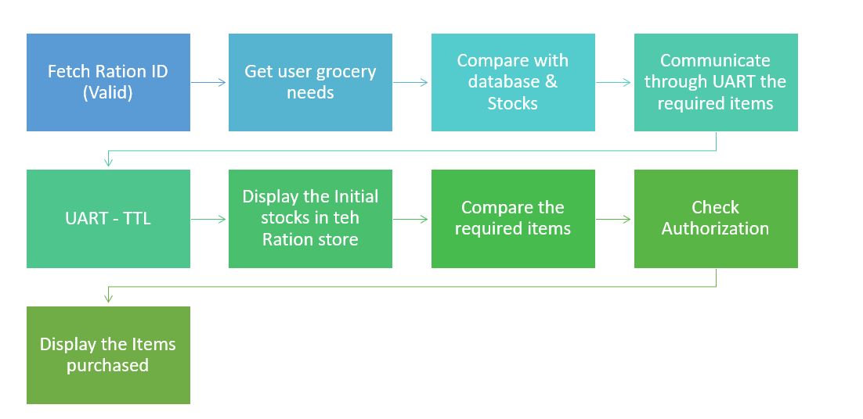
3/16/2026

Slide 14
METHODOLOGY
The system begins with the consumer interacting with a MATLAB graphical user interface where they select the required ration items such as rice, sugar, dhal, and oil along with the desired quantity. The MATLAB program processes the input and converts the data into a suitable digital format for communication. The processed data is transmitted to the FPGA board through UART communication. Once the FPGA receives the data, it performs stock analysis by comparing the requested quantity with the available stock stored in the system memory. Based on this analysis, the FPGA updates the remaining stock levels and performs authorization using low-power digital configuration logic. Finally, the updated stock information and transaction results are displayed on the LCD module connected to the FPGA. The system continues to monitor new consumer inputs and updates the ration stock information in real time.
3/16/2026

Slide 15
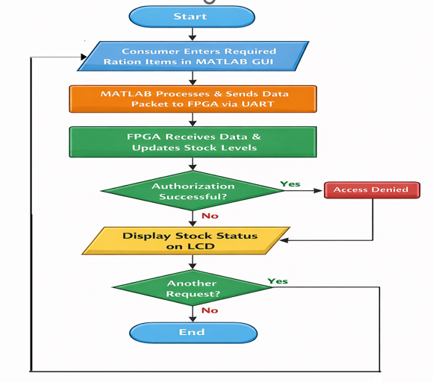
FLOW DIAGRAM
3/16/2026

Slide 16
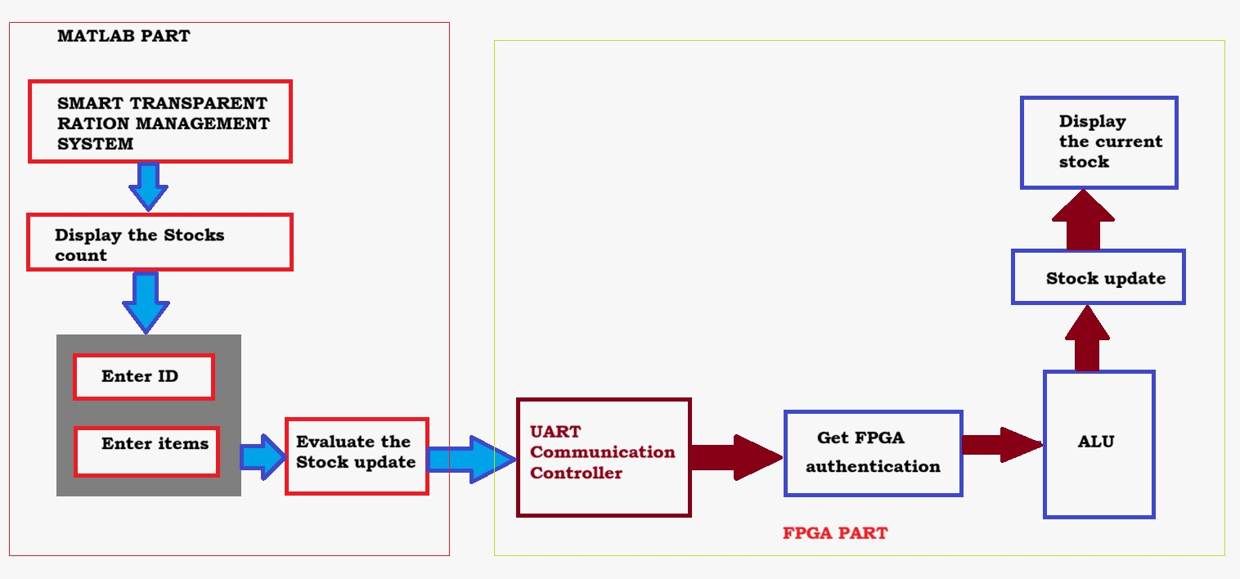
BLOCK DIAGRAM
3/16/2026

Slide 17
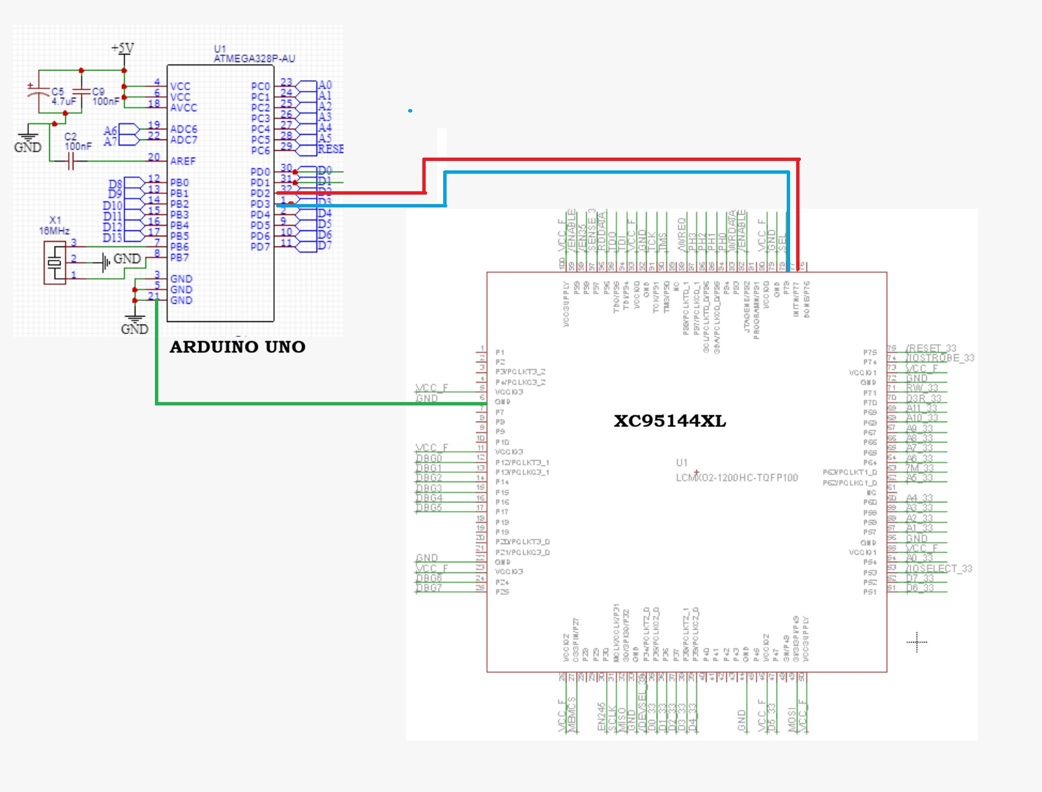
CIRCUIT DIAGRAM
3/16/2026

Slide 18
Hardware Design Explanation
The system uses an Arduino Uno (ATmega328P) as the main controller to process input signals and control the authorization logic.
The XC95144XL CPLD (VLSI device) is used to implement high-speed digital logic and secure authorization operations.
Communication between the Arduino and CPLD is established through digital I/O pins for data transfer and control signals.
The Arduino sends input data to the CPLD, which performs hardware-based verification and logic processing.
The design ensures fast processing, reliable authentication, and efficient hardware control for the ration authorization system.
3/16/2026

Slide 19
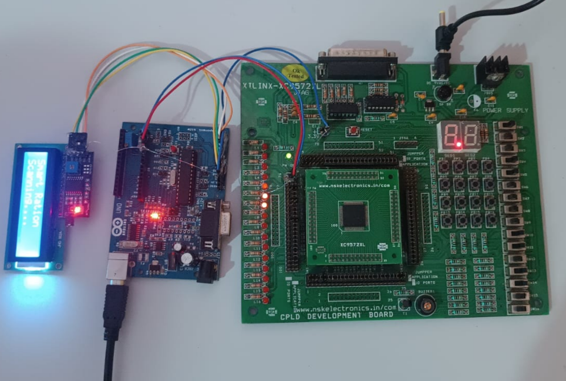
HARDWARE IMPLEMENTATION
3/16/2026

Slide 20
TESTING AND RESULTS
The proposed system was tested using Arduino and CPLD (XC95144XL) to verify hardware communication and logic operation.
Input signals were provided from the Arduino to the CPLD, and the authorization logic was successfully executed.
The system correctly performed authentication and control operations based on the programmed logic.
Experimental results showed stable performance, fast response, and reliable hardware processing.
The testing confirmed that the system can efficiently support secure ration authorization and distribution.
3/16/2026

Slide 21
APPLICATIONS
Public Distribution System (PDS): Secure authorization for fair ration distribution.
Government Welfare Schemes: Authentication of beneficiaries for subsidy programs.
Smart Ration Shops: Automated and transparent ration management.
Inventory Monitoring: Helps track and control distribution of food grains.
Smart Governance Systems: Improves efficiency and reliability of public service delivery.
3/16/2026

Slide 22
ADVANTAGES
Improves security in the ration distribution system.
Prevents duplicate ration cards and unauthorized access.
Reduces manual errors and fraud in the Public Distribution System.
Provides faster and reliable authentication using VLSI technology.
Ensures transparent and fair distribution of essential commodities.
3/16/2026

Slide 23
FUTURE SCOPE
The system can be integrated with biometric authentication (fingerprint or face recognition) for stronger security.
It can be connected with IoT and cloud technology for real-time monitoring of ration distribution.
Mobile or web applications can be developed for beneficiaries to track ration availability and usage.
Advanced VLSI chips can be designed for faster processing and improved system performance.
The system can be expanded to support smart governance and digital public service platforms.
3/16/2026

Slide 24
CONCLUSION
The proposed VLSI Based Ration Authorization System provides an efficient and secure solution for improving the Public Distribution System. By integrating VLSI technology with embedded system design, the system enables reliable authentication of beneficiaries before distributing ration supplies. This helps in preventing unauthorized access, duplication of ration cards, and fraudulent activities.
The implementation of automated authorization reduces manual errors and increases transparency in the ration distribution process. It also improves the monitoring and control of food grain delivery in ration shops. Therefore, the proposed system enhances the efficiency, reliability, and fairness of government welfare services while supporting the effective distribution of essential commodities.
3/16/2026

Slide 25
REPORT COMPLETION
The report on “VLSI Based Ration Authorization System” has been successfully completed.
It includes problem analysis, literature survey, system design, implementation, testing, and results.
The report explains how VLSI and embedded technology improve security and transparency in ration distribution.
Overall, the project demonstrates an efficient solution for secure and fair Public Distribution System management.
3/16/2026

Slide 26
REFERENCES
Ahmed, T and Hussain, S., “Automated ration distribution model using RFID authentication and microcontroller technology,” International Journal of Smart Public Distribution Systems, vol. 6, no. 2, pp. 41–49, 2019.
Chattopadhyay, R and Harris, P., “Digital solutions for improving public distribution systems using automation and electronic authentication,” International Journal of Public Distribution Technologies, vol. 10, no. 4, pp. 115–124, 2020.
Dinesh Kumar, K and Mukherjee, A., “Automated ration distribution model using microcontrollers and digital weighing mechanisms,” Journal of Embedded Systems in Public Welfare, vol. 8, no. 3, pp. 67–75, 2022.
Farooqh Ali, S., Imran, S and Nirmala Devi, K., “Smart automated ration vending machine using Internet of Things technology,” International Journal of IoT Applications in Public Distribution, vol. 9, no. 1, pp. 34–42, 2023.
Hanran Wang, H., Zheng, Z., Sui, Q., Liu, C., Yan, F and Chen, W., “Energy scheduling model for DC microgrid groups integrating mobile energy storage under power rationing,” Journal of Smart Energy Systems, vol. 7, no. 2, pp. 54–62, 2025.
3/16/2026

Slide 27
REFERENCES
Karthik, M and Prasad, V., “Smart ration distribution system using RFID technology and GSM communication modules,” International Journal of Embedded Communication Systems, vol. 6, no. 3, pp. 80–89, 2021.
Khan, A and Prasad, V., “Smart ration distribution monitoring platform integrating automated ration dispensing and database management,” International Journal of Digital Public Distribution Systems, vol. 6, no. 3, pp. 80–89, 2020.
Mehta, G., Tiwari, R and Soni, P., “Mobile-based ration distribution information system for beneficiary notification,” Journal of Rural Technology Solutions, vol. 5, no. 4, pp. 101–108, 2020.
Naveen, B., Ajay, M. R., Akash, H. M., Bharath, D. S and Chethan, S., “Automatic ration distribution system using RFID and automated dispensers,” International Journal of Smart Rural Distribution Systems, vol. 9, no. 2, pp. 58–69, 2022.
Patel, H., “Ration shop automation system using embedded controllers and digital weighing sensors,” International Journal of Embedded Systems in Public Welfare, vol. 9, no. 2, pp. 58–69, 2021.
3/16/2026

Slide 28
THANK YOU
3/16/2026

